Slide 1
Radar Scattering Prediction
HP Marshall, Jonas Jans, Anuhya Bhagavatula, Shrusti Ghela, Yiying Gao, Samuel Marcus, Aaliyah Hänni
Notes:
Jonas

Slide 2
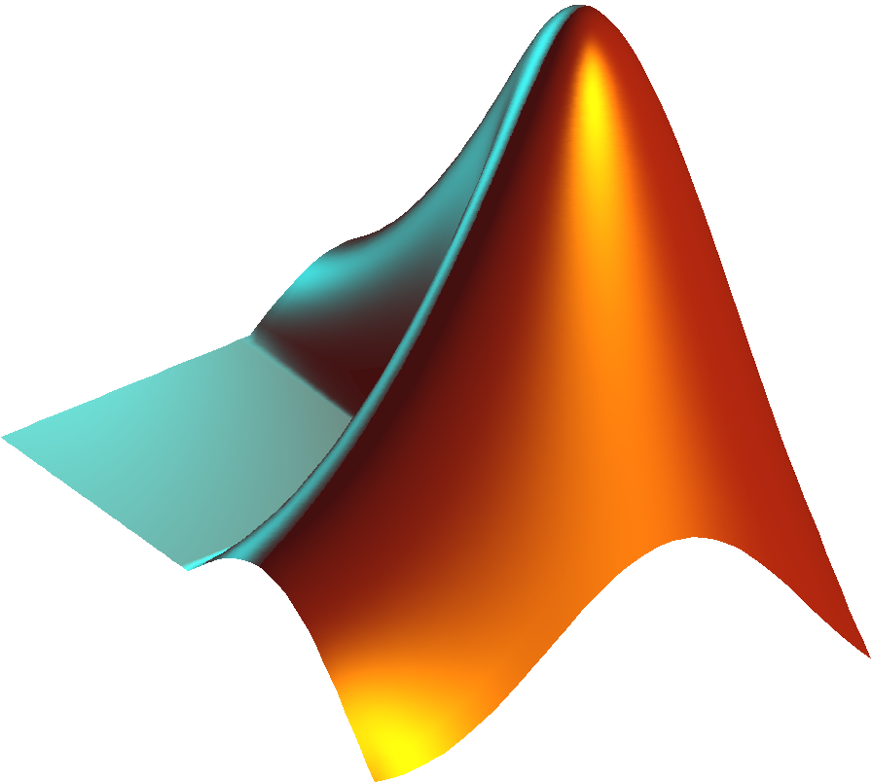




Wonderful team members!
Notes:
Jonas

Slide 3
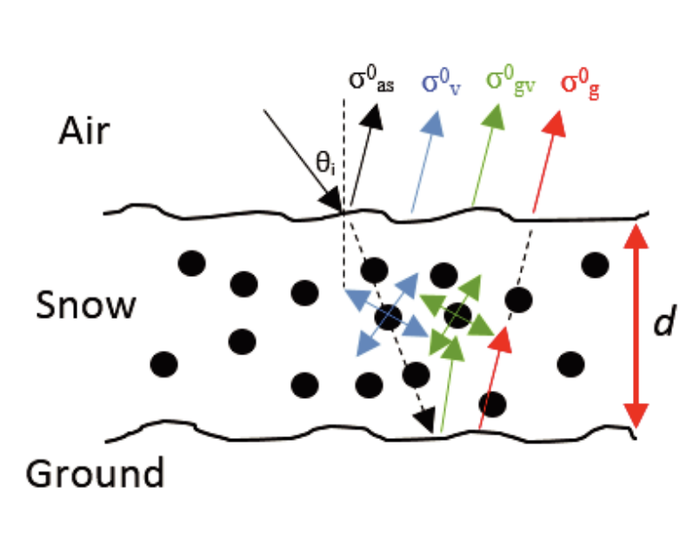
Problem Statement
Are DMRT, snow pit measured inputs (snow depth, grain size, temperature and density), sufficient to model backscatter using a ML model?
Can we relate DMRT tuning parameters to snow-pit observed variables?
Image Source: https://www.jpier.org/PIERB/pierb81/04.18042803.pdf
Notes:
Jonas These pit parameters are used within DMRT

Slide 4
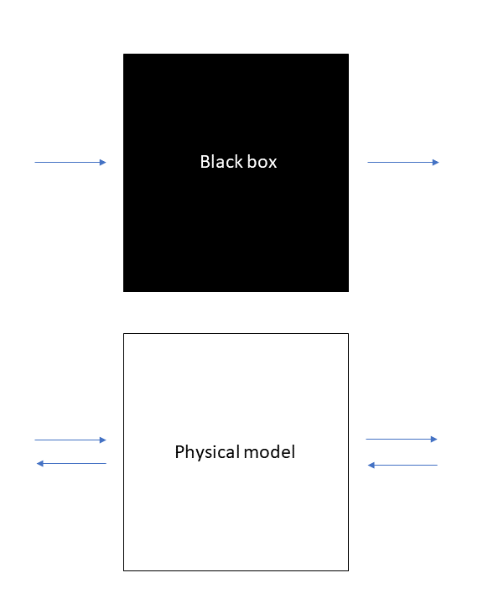
Custom ML model: predict backscattering from snow pits
DMRT model: predict backscatter
Evaluate variable importance
Predict SWE from scattering
Notes:
Jonas How much do the parameters influence the model output? When having clear estimations of model parameters you can, in theory, try an inverse modeling where you start from a backscatter value and extract snow height

Slide 5
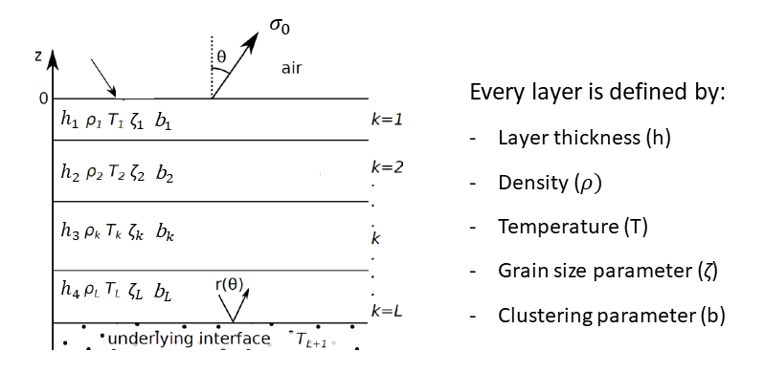
Dense Medium Radiative Transfer model
Attempt to estimate backscatter based upon input parameters
DMRT-Bic: model which accounts for volume scattering using a bicontinuous medium to create snow microstructure
Source: https://ntrs.nasa.gov/api/citations/20150000366/downloads/20150000366.pdf
Notes:
Jonas A lot of DMRT models that try to describe the snow microstructure in a different way

Slide 6
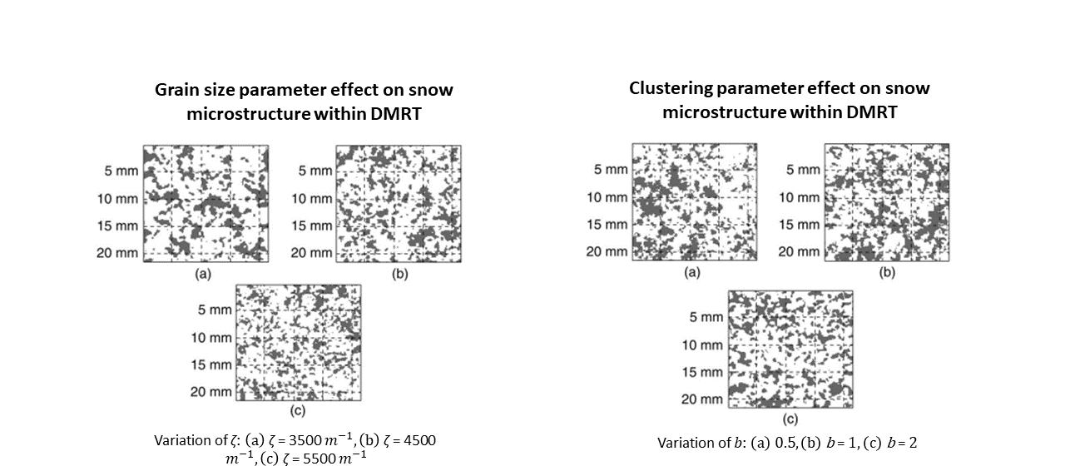
DMRT-Bic tuning parameters
Source: W. Chang et al. (2014)
Notes:
Jonas

Slide 7
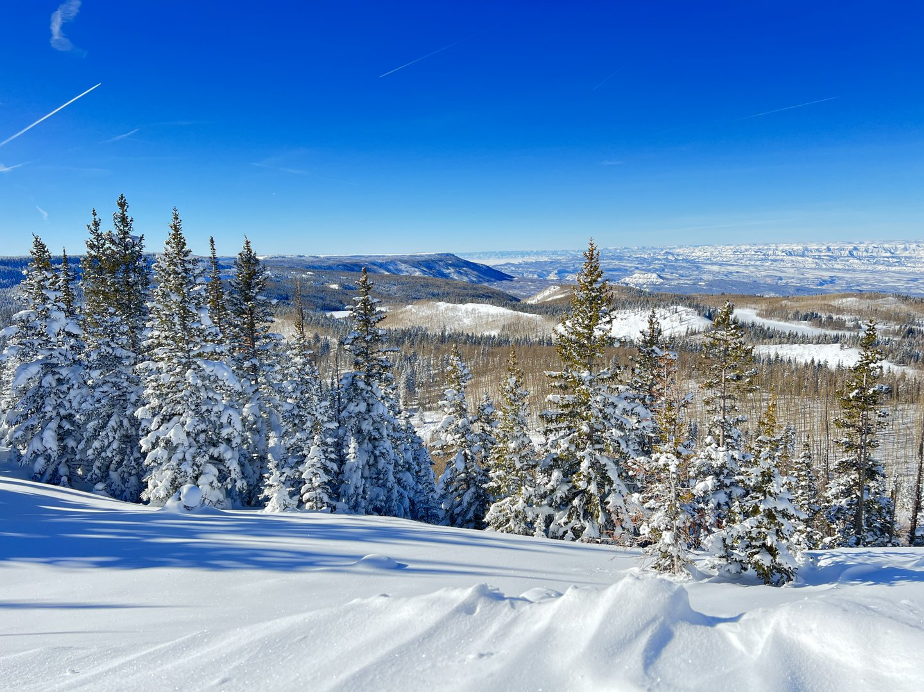
Snow Pit Data
Where
Grand Mesa, CO
When
January - March 2022
What
136 Snow Pits
4784 UAVSAR Rasters
4 Polarisations (L-band)
GPR SWE measurements (extracted around pit locations)
Notes:
Anuhya

Slide 8
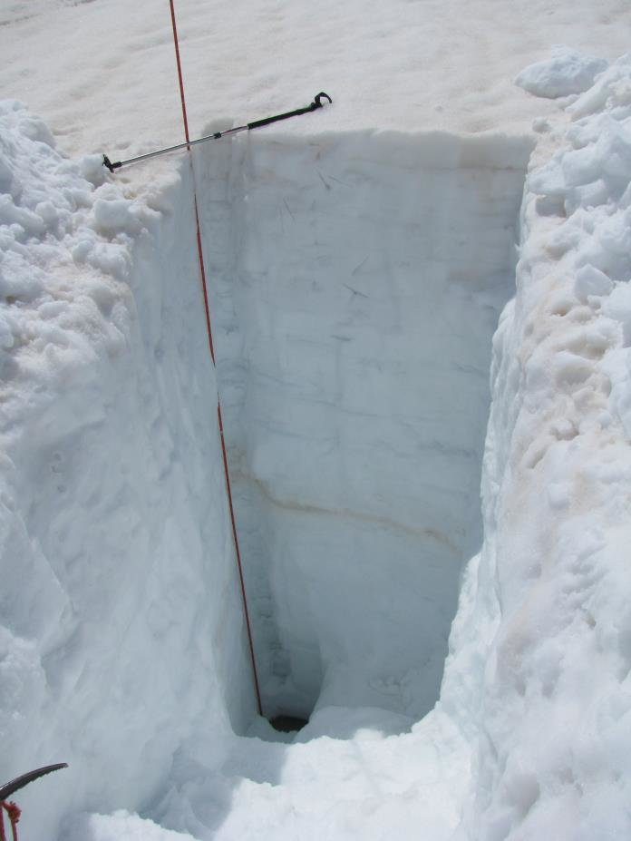
Preprocessing snow pit measurements
Select pit locations without tree cover
Extract layer thickness, snow density, average particle size and temperature per layer
Create table for DMRT processing
Average variables over all layers
Create table for ML application
Notes:
Anuhya

Slide 9
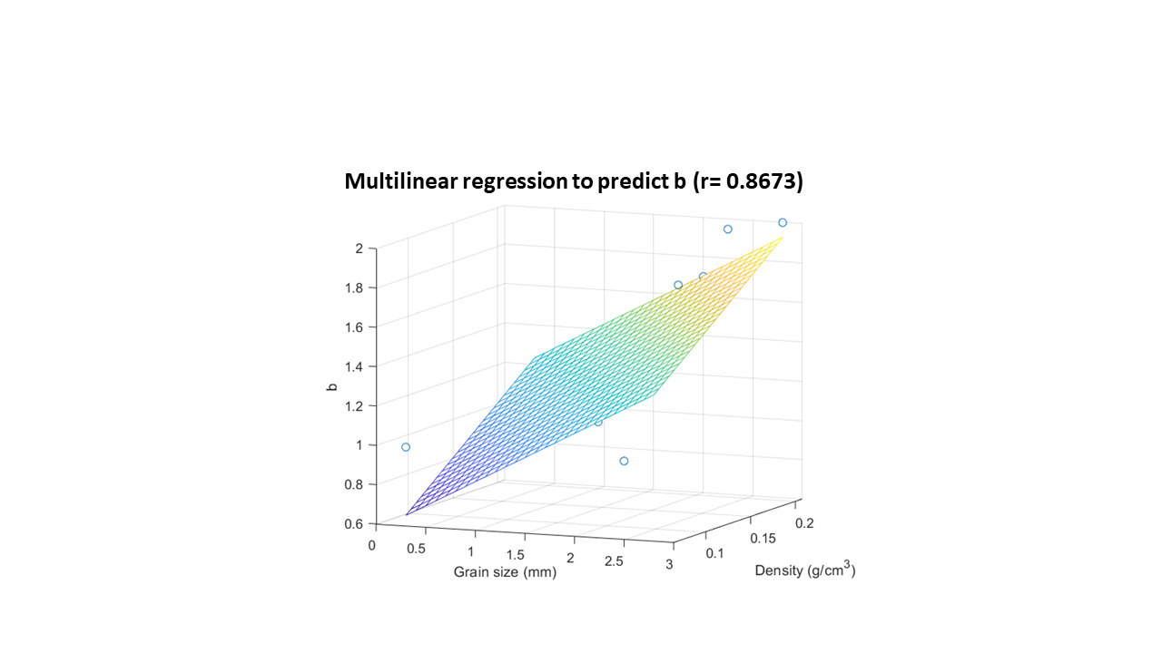
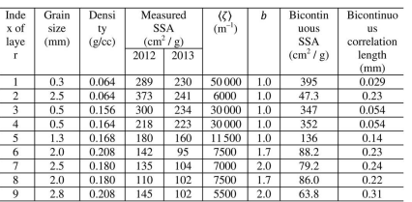
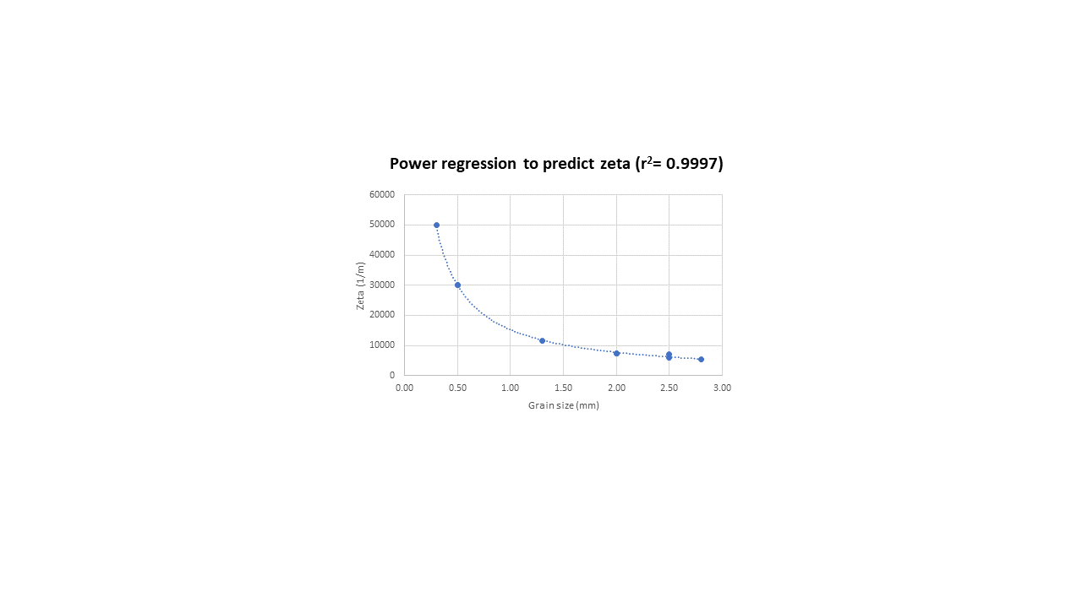
DMRT tuning parameter prediction
Link snow pit variables and tuning parameters
Source: W. Chang et al. (2014)
Regressions used on all extracted pit layers => pits ready for DMRT runs
Future work: Run DMRT to check if extrapolation tuning parameters is possible
Notes:
Jonas

Slide 10
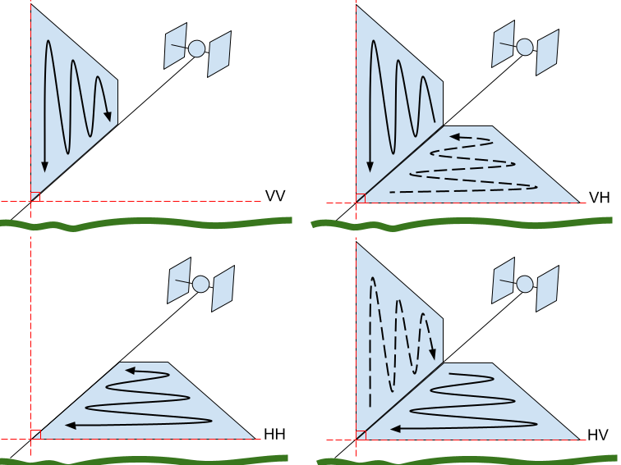
UAVSAR Polarizations + Preprocessing
Code | Transmit Signal Polarization | Return Signal Polarization
HH | horizontal | horizontal
VV | vertical | vertical
HV | horizontal | vertical
VH | vertical | horizontal
Preprocessing Steps
Gathered all Grand Mesa Feb 2nd & 12th, 2022 UAVSAR Raster Images
Averaged amplitude for 50m radius around each Grand Mesa snow pit
Averaged amplitudes for both dates
Image Source: https://hyp3-docs.asf.alaska.edu/guides/introduction_to_sar/
Notes:
Aaliyah

Slide 11
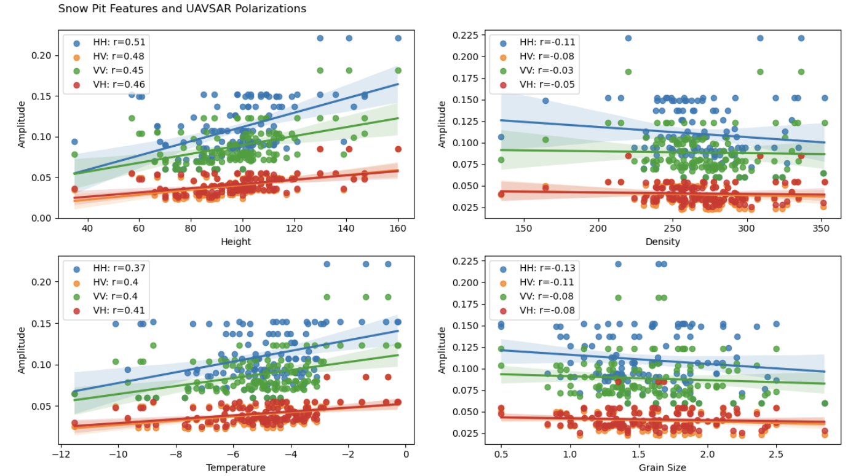
UAVSAR Amplitudes & Snow Pit Features
Notes:
Aaliyah

Slide 12
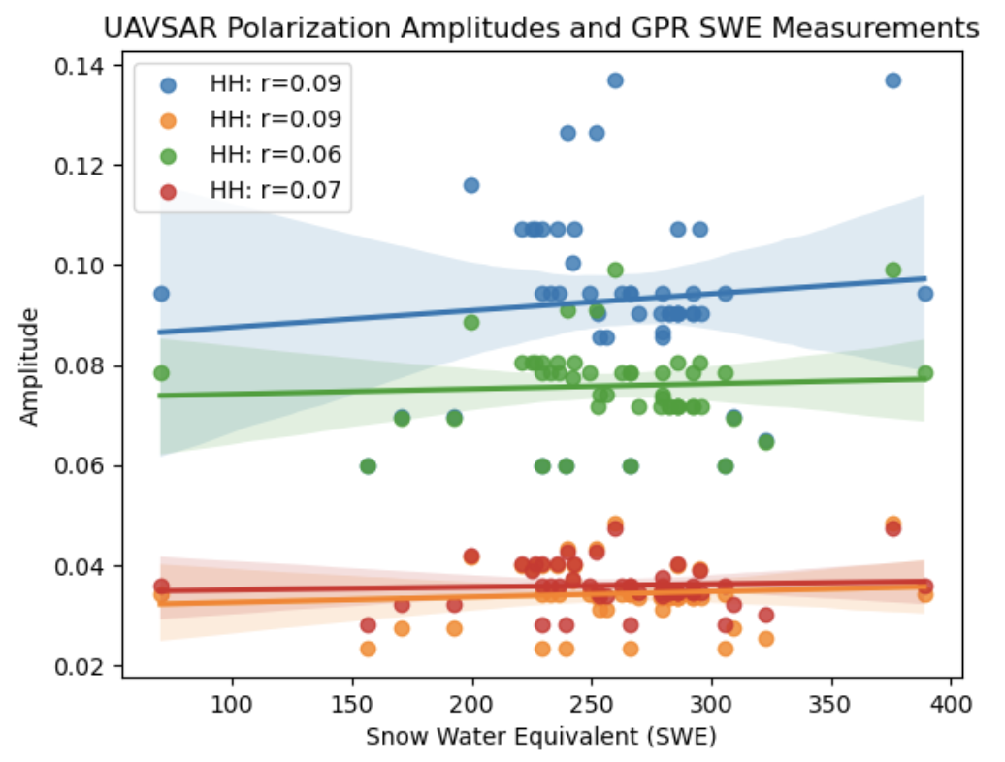
UAVSAR Amplitudes & GPR Measurements
Notes:
Aaliyah

Slide 13
Regression Algorithms
Multiple Linear Regression
Decision Tree
Random Forest
Notes:
Anuhya

Slide 14
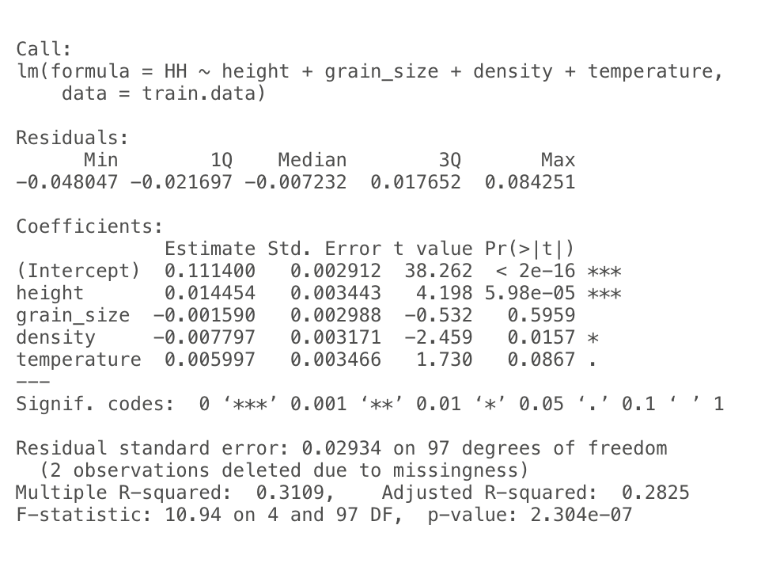
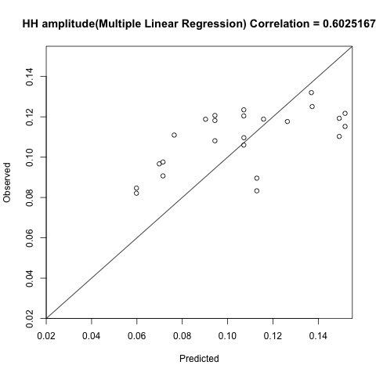
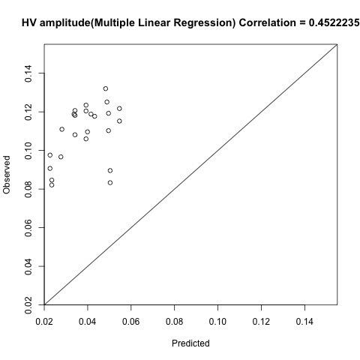
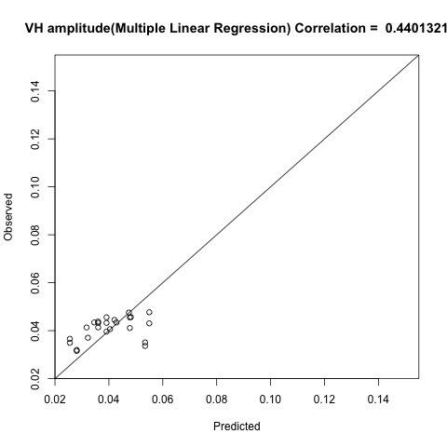
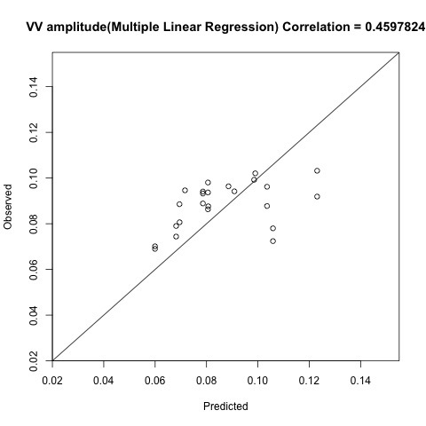
Multiple Linear Regression - Results
Notes:
Anuhya

Slide 15
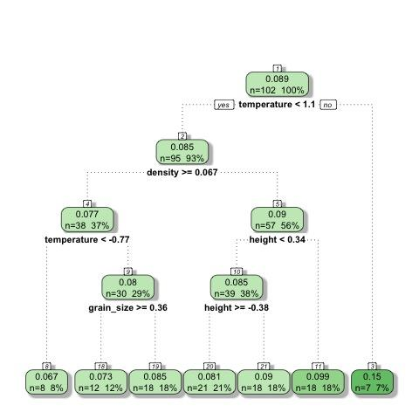
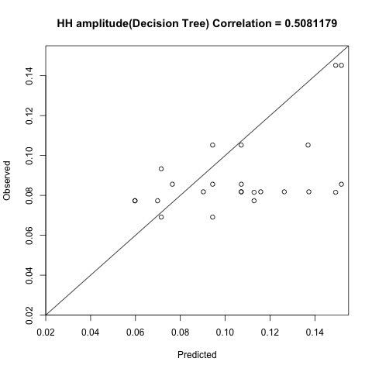
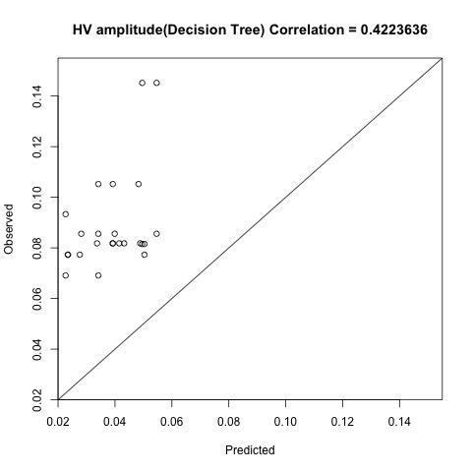
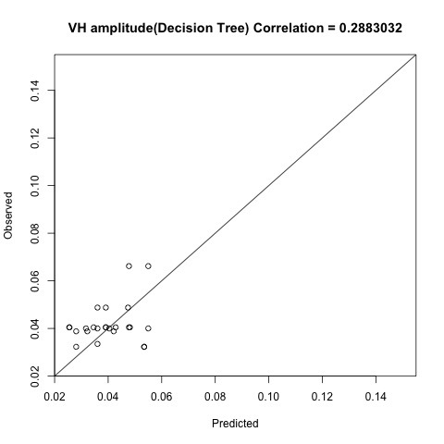
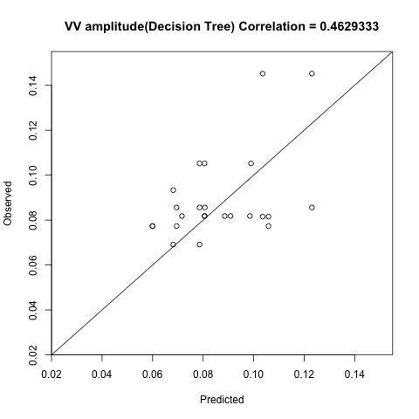
Decision Tree - Results
Notes:
Anuhya

Slide 16
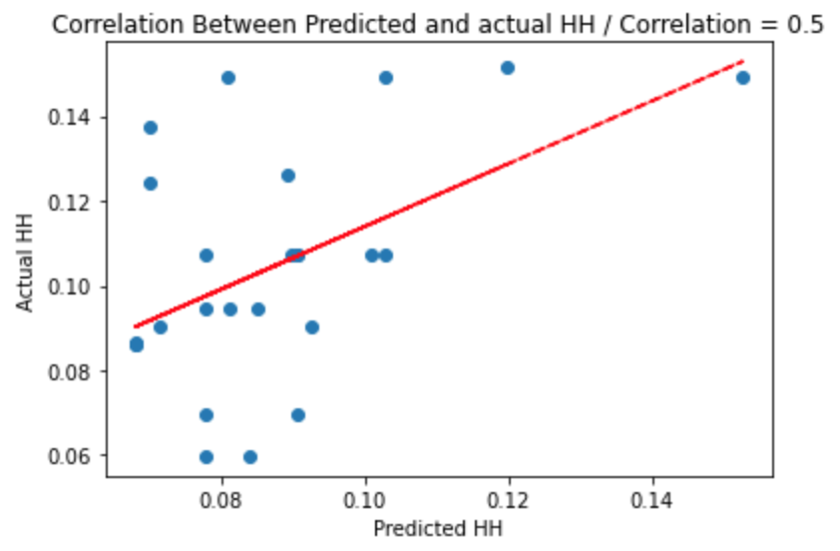
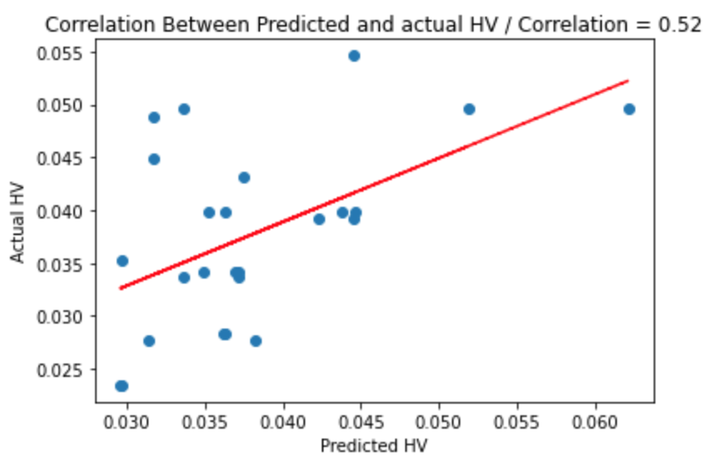
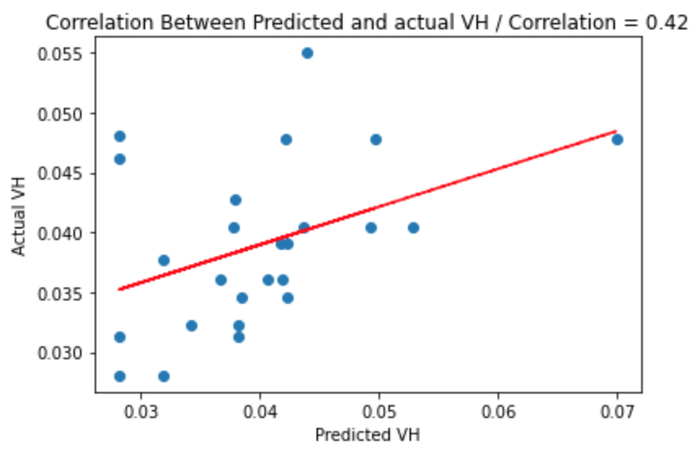
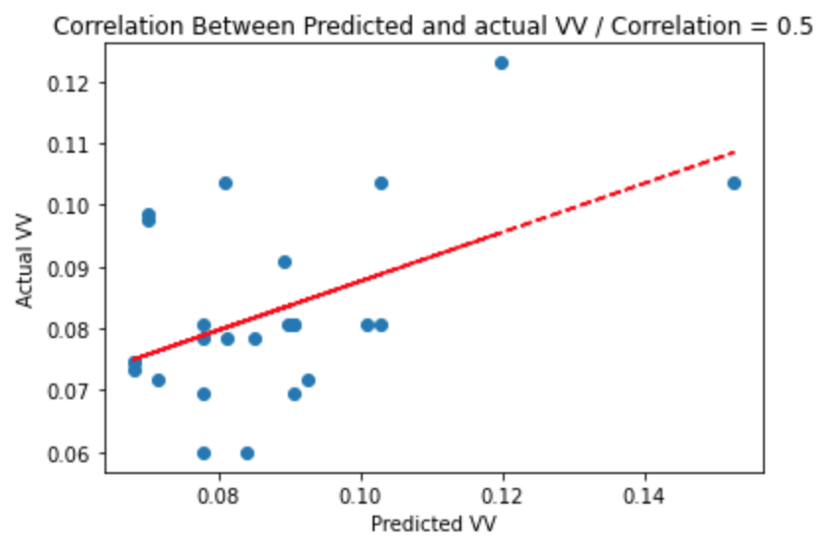
Random Forest - Results: Proficiency
Notes:
Yiying

Slide 17
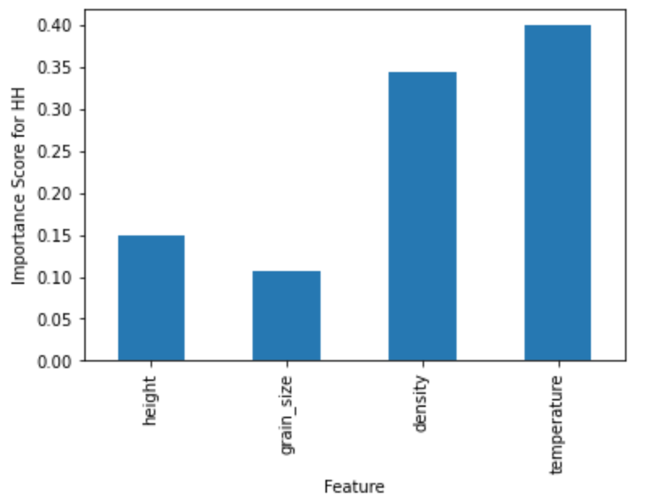
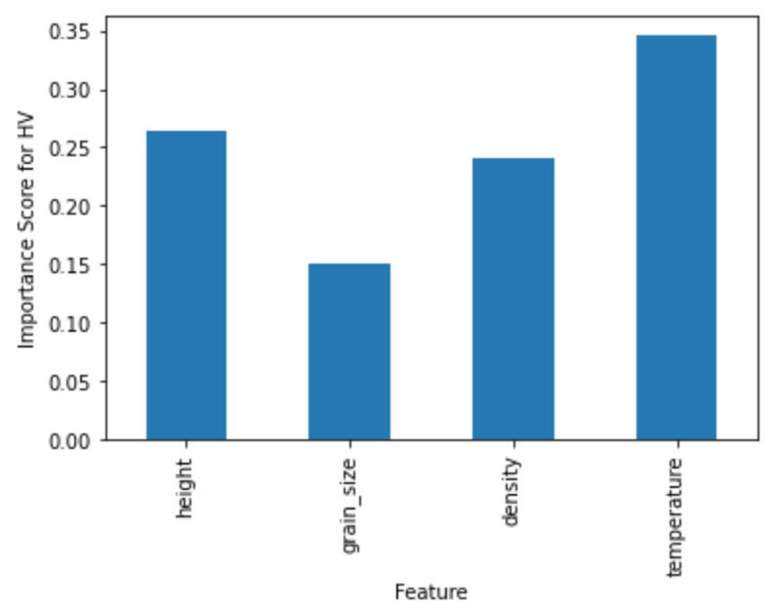
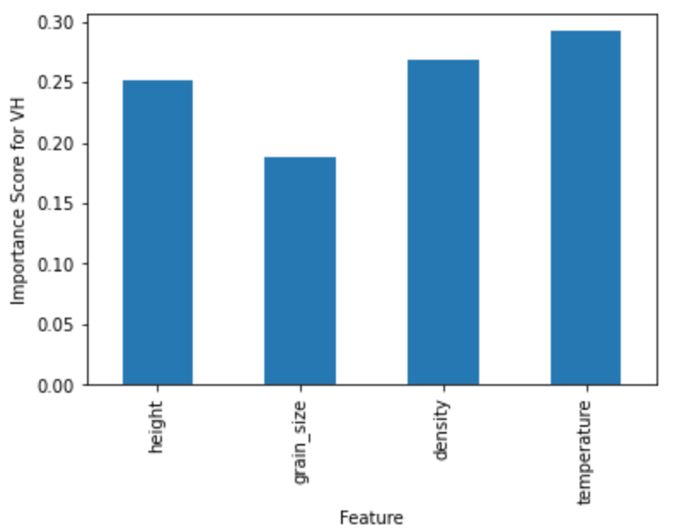

Random Forest - Results: Variable importance
Notes:
Yiying

Slide 18
Results & Findings
Overall best model fit was multiple linear regression
Temperature & Density were consistently identified as important features for predicting backscatter
Height & Grain size were inconsistent in feature importance between varying models and polarizations
Very informative experience for all team members
Results & Code in Radar Scattering GitHub https://github.com/snowex-hackweek/radar_prediction
Notes:
Sam

Slide 19
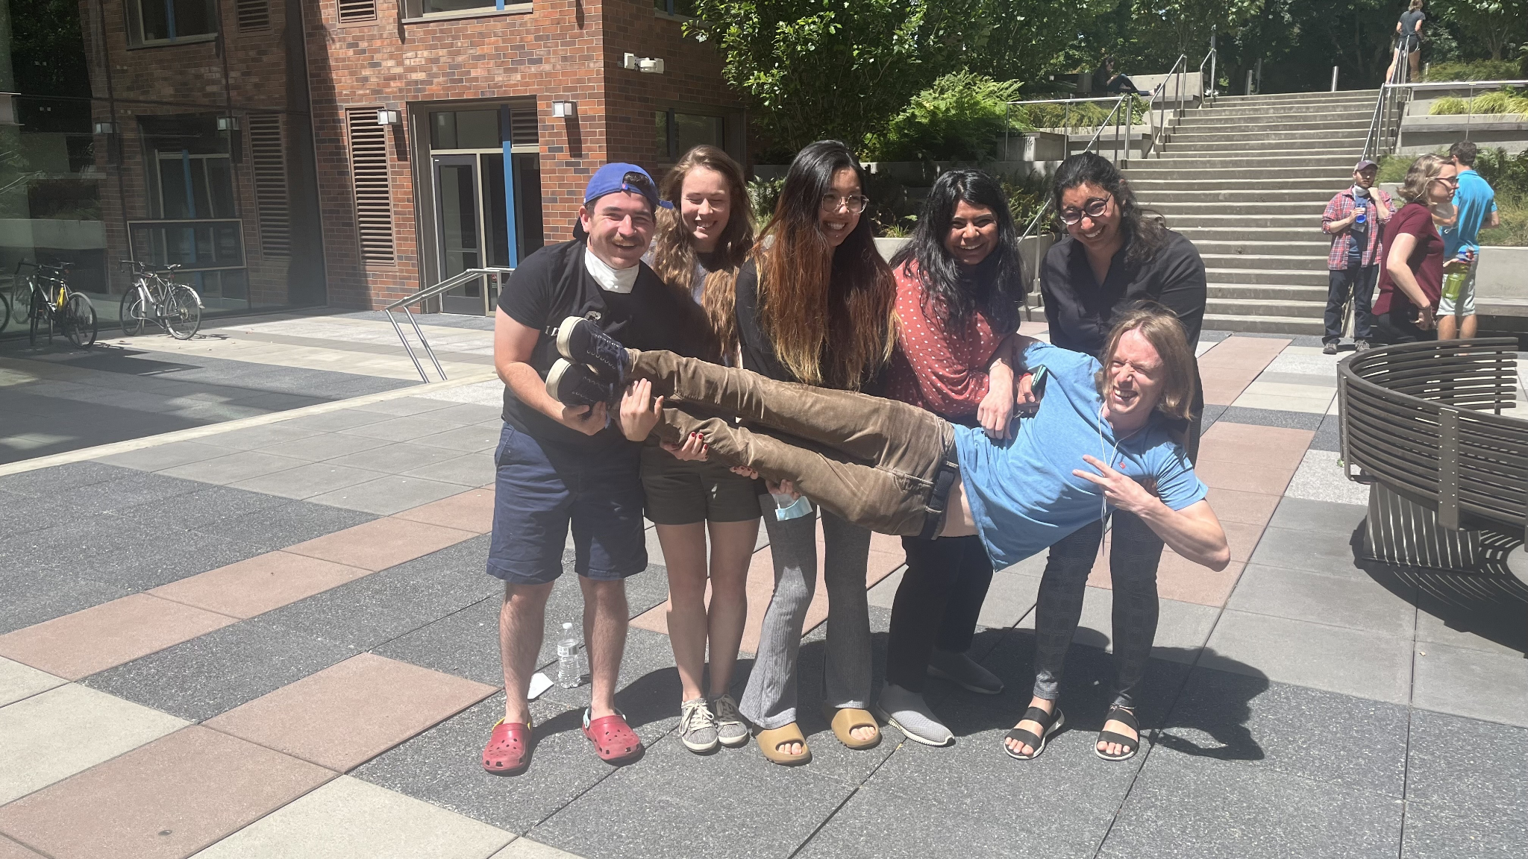
Future Works
DMRT tuning parameters over all non forested pits in Grand Mesa ready for DMRT model runs and comparison with observed backscatter data
Include SWE & LWC snowpit parameters in ML models
Include other frequencies (SWESAR, Sentinel 1) in ML models
Notes:
Sam

Slide 20


Thank you to SnowEx Hackweek Coordinators, SnowEx Contributors, Tutorial Leads, Technical Team!
Notes:
Sam

Slide 21
References
“A Raster Union and More Example” snowexsql, 15 Jul. 2022, https://snowexsql.readthedocs.io/en/latest/gallery/raster_union_and_more_example.html
Jack Tarricone, Zach Keskinen, “UAVSAR Data Products”, SnowEx Hackweek 2022 15 Jul. 2022, https://snowex.hackweek.io/tutorials/uavsar/2_types_of_uavsar_images.html
W. Chang, S. Tan, J. Lemmetyinen, L. Tsang, X. Xu and S. H. Yueh, "Dense Media Radiative Transfer Applied to SnowScat and SnowSAR," in IEEE Journal of Selected Topics in Applied Earth Observations and Remote Sensing, vol. 7, no. 9, pp. 3811-3825, Sept. 2014, doi: 10.1109/JSTARS.2014.2343519.
Notes:
Sam

